Slide 1
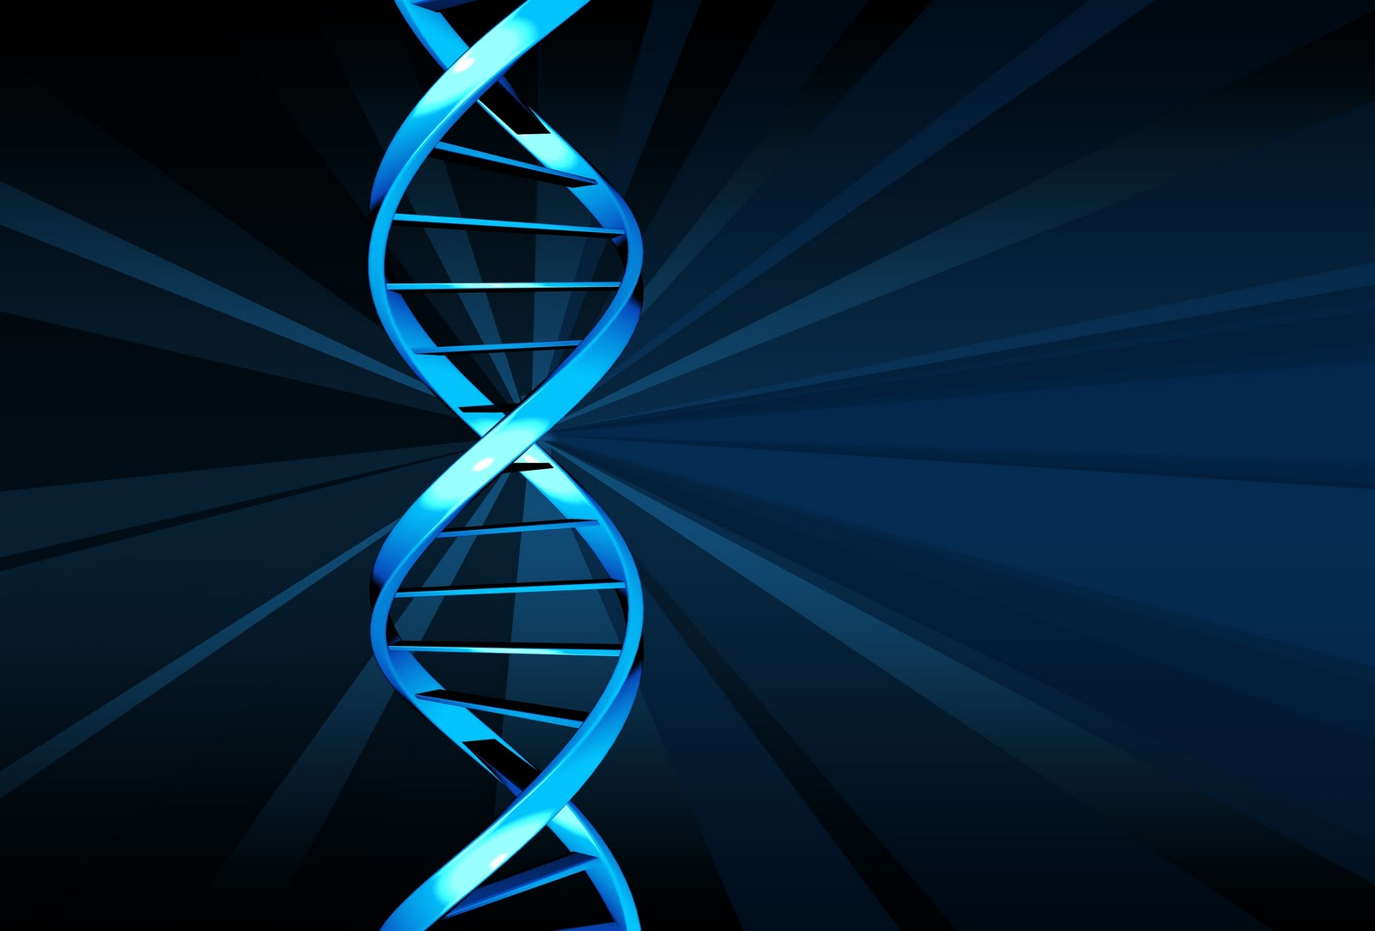
DNA BioSensors
Chad Oser
Shalin Kushwaha
Tyler Koenig
Wang Wenbo
Notes:
http://www.drewlawrence.com/articles/04-Imprint-of-Sex-Act.php

Slide 2
What is DNA?
Notes:
Microsoft

Slide 3
optical sensors

Slide 4
optical sensors
High sensitivity
fast response
able to perform real-time measurements

Slide 5
optical sensors
Emission
Absorption
Fluorescence
Refractometry
Polarimetry

Slide 6
photonic biosensors
based on evanescent wave detection
extremely high sensitivity for the direct measurement of bio-molecular interactions, in real time and in label-free schemes

Slide 7
Evanescent Wave Photonic Biosensor
A receptor layer is immobilized onto the core surface of the waveguide.
The exposure of the functionalized surface to the complementary analyte molecules and the subsequent biochemical interaction between them induces a local change in the optical properties of the biological layer.

Slide 8
optical sensing platforms
optical fibers
planar aveguide structures
microresonators
resonant waveguide diffractive structures
light addressable potentiometric devices
micromechanical structures with optical readout
porous silicon

Slide 9
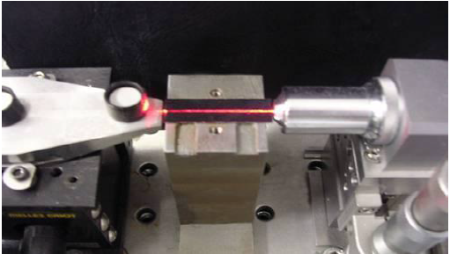
Nanophotonic Si Sensor

Slide 10
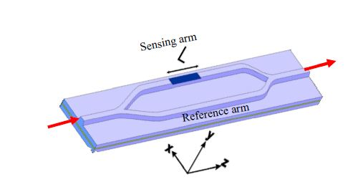
Mechanism of Mach-Zehnder interferometer configuration
Consists of two arms, sensing arm and reference arm
Evanascent field of light interacts with the environment in the sensor area
Refractive index change in the sensor area produces phase shift between the light travelling in the two beams, resulting in a change in the interference signal of the MZI device
Fig. 1: Mach-Zehnder interferometer

Slide 11
Design (continued)
One channel is called the sensing arm while the other is the reference arm. In the reference arm there is no change in evanescent field but in the sensing channel the light interacts with the environment creating a phase shift
When the two beams are directed back together the device can detect a phase difference that can indicate a change in DNA. This technique is known as cladding.
High surface sensitivity (n) is important when detecting the change in refraction

Slide 12

Nanophotonic interferometer design
Where I_{s} and I_{R} are the intensity of lights in the sensor arm and the reference arm respectively

Slide 13

Formula for surface sensitivity
For biosensing applications, the optical waveguides of the integrated MZI must achieve two main characteristics: to have a high surface sensitivity and single mode behavior.
ηsup is the surface sensitivity
N is the variation of the effective propagation index of the guided modes
dl is the thickness of a homogeneous biological layer changes

Slide 14
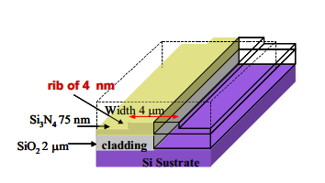
Fabrication
A micro-channel is formed by patterning SU 8 photoresist to form a micro-channel of 4nm x 4 um.
2 µm thick silicon dioxide cladding layer that makes n=1.46
75 nm thick Silicon nitride core layer with n = 2.00

Slide 15
Nanophotonic Sensors Experimental Setup
The evaluation for the sensitivity of the sensor was done by flowing solutions of water and ethanol of varying concentration through the channels and, therefore, causing different refractive index
By measuring the output signal of the MZI in real time we can use these measurements, and calibrate a curve where the phase response of the sensor is plotted versus the variation in the refractive index.

Slide 16
Applications
Applied for DNA testing and for detection of single nucleotide polymorphisms at BRCA-1 gene, involved in breast cancer development, without target labeling

Slide 17
Bio-microfluidics

Slide 18
Bio-microfluidics
The application of biologically derived materials and biologically inspired designs to microfluidics and the applications of the resulting devices.

Slide 19
Bio-microfluidics
Microfluidics deals with the dynamics and engineering of fluids confined on the micrometer (or smaller) scale.

Slide 20
Bio-microfluidics
Inherently unique dynamics
Boundary driven effects
diffusion driven mixing
fast thermal dissipation

Slide 21
Bio-microfluidics
Manufactured from materials used in the semiconductor
Metals
Semiconductors
Glasses
Generally difficult to chemically functionalize for biological and chemical sensitivity, and also generally require organic solvents or thermal processing for device manufacture

Slide 22
Bio-microfluidics
Polydimethylsiloxane (PDMS) ---- inexpensive microfluidic systems via rapid prototyping
lacks the ability to be easily functionalized with biologically active components due to the solvent or thermal processing requirements

Slide 23
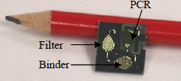
Bio-Microfluidic Lab-On-A-Chip DNA Sensor

Slide 24
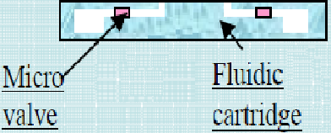
Design/Fabrication
-PDMS material used for microfluidic components and chip encapsulation of microfluidic chamber.
-Microfluidic channels, reservoirs, and valves are formed on a polymer substrate.

Slide 25
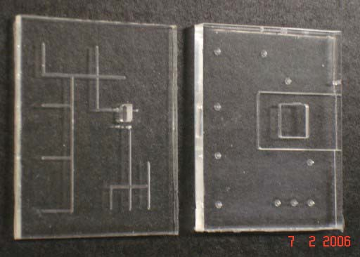
Design/Fabrication
A closed fluidic channel is formed by bonding the lower PDMS substrate with horizontal channel onto an upper PDMS substrate with vertical ports
A channel with 500um dimension is formed on PDMS substrate and is connected to the chip inlet port
Fig. : Lower and upper substrate with fluidic channel

Slide 26
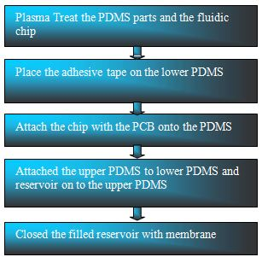
Design/Fabrication (continued)
The assembly process starts with cleaning of the substrate by oxygen plasma treatment process
Fig. : Process flowchart for microfluidic package

Slide 27
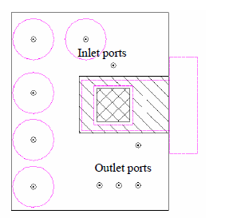
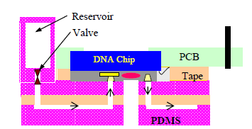
Design/Fabrication (continued)
In between the fluidic chip and DNA chip there are micro machined inlets and outlets which allow blood to flow through

Slide 28
Design/Fabrication (continued)
-The DNA chip is fabricated on silicon and contains a filter, binder, and Polymer Chain Reaction (PCR) chamber.
  Filter separates DNA from blood sample.
  Binder is used to trap the DNA sample on the chip
  The Sample is then removed from the chip using a process called elution and is then mixed with a primer and injected into the PCR chamber where further processes are performed.

Slide 29
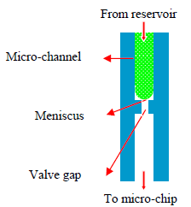
Design/Fabrication (continued)
-Valve controls the flow of reagent from reservoir to DNA chip inlets and outlets.
  Valve is a vertically placed pressure controlled micro-channel that uses a threshold pressure that allows blood to flow. This method is simple and efficient because it doesn’t require any moving parts.
  Pressure is controlled by an external piston and is used to adjust flow rate by changing the piston’s pushing speed.
Fluidic substrate and DNA chipped are attached using anodic bonding method.

Slide 30
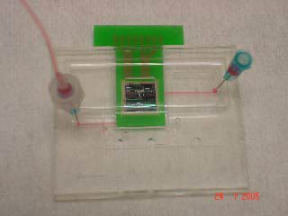
  PDMS Cartridge Testing
One of the first things to be tested is to test for fluidic leakage and cross contamination.
Color liquid is passed through the device for a visual eye test to determine mixing and if any leaks.

Slide 31
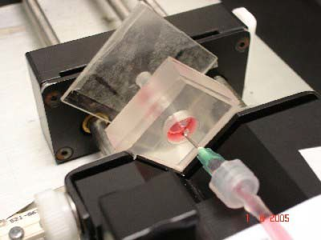
Reservoir Testing
The Reservoir test is used to test constant flowrate to the reservoirs.
Pistons are used to create the constant flow rate

Slide 32
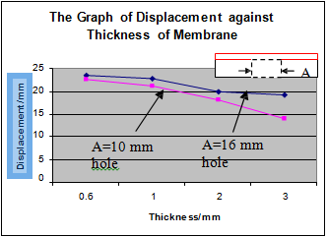
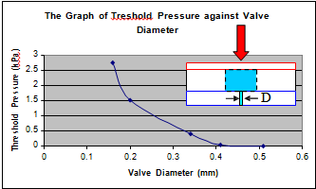
Finding optimal membrane thickness
Four types of membrane were fabricated with varying thicknesses from 0,6mm,1.0mm,2.0mm, and 3.0mm.
They were attached to 10mm and 16mm holes. Next an external actuator applies pressure on the membrane to push it deep into the holes until the membranes break.

Slide 33
Surface Enhanced Resonance Raman Scattering

Slide 34
SERRS
Adsorb a colored molecule onto a suitable roughened metal surface.
Irradiate surface with a laser beam
Collect scattering with a standard Raman spectrometer.
A roughened surface is required for scattering

Slide 35
SERRS
Silver gives better enhancement than gold
To obtain maximum enhancement the particles need to be aggregated into discrete clusters
The nature of the aggregating agent depends on the chemical adsorption properties of the analyte

Slide 36
SERRS
DNA does not meet the requirements for SERRS
lack of a suitable visible chromophore
Highly negatively charged phosphate backbone

Slide 37
SERRS
To make DNA SERRS active
Add a label either as a non-sequence specific intercalator or as a specific label covalently attached to a unique probe sequence
Down side of using intercalators : no sequence specific information generated.

Slide 38
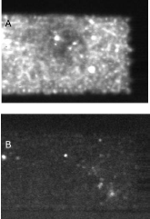
Surface Enhanced Resonance Raman Scattering (SERRS)

Slide 39
Advantages of SERRS
One attractive aspect of SERRS over complementary technologies is the reported ease of performing multiplexed experiments without the need for separation of each of the individual components
This benefit has been demonstrated in determining a number of nucleic acid sequences employing commercially available SERRS-active fluorescent labels

Slide 40
Surface Enhanced Resonance Raman Scattering (SERRS)
Designed to perform 2 tasks
  1. Be able to trap the streptavidin-coated microspheres in order to capture biotinylated PCR product
  2. Mix the effluent from the packed bead after thermal release

Slide 41
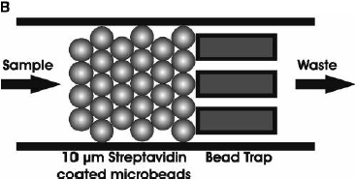
Design Specifications
Microfilter membrane was used to retain beads within the device
Dimensions:
  110 um long channels
  26um x 100um
  Spaced in 8 um intervals

Slide 42
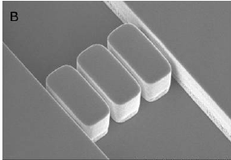
Fabrication
The device was fabricated using PDMS material to decrease cause and make easier to dispose
Molded in a Si master mold that was fabricated using traditional photolithography and bulk micro machining methods.

Slide 43
SERRS Experimental Setup
Fluids are controlled on-chip by means of two external precision syringe pumps fitted with 25-uL syringes. These pumps are controlled using a Labview environment. Each pump is operated at a constant flow rate.
Raman measurements are taken for on and off chip using a raman systems fiber-coupled portable spectrometer.
The spectrometer is adapted with long working distance to enable SERRS signals to be collected.
In order to achieve the elevated temperature of 95 degrees Celsius a miniature peltier heating system was used.

Slide 44
References
J. Sánchez Del Río a , L.G. Carrascosa a , F.J. Blanco B , M. Moreno a , J. Berganzo B , A. Calle a , C. Domínguez a and L. M. Lechuga a. "Lab-on-a-chip Platforms Based on Highly Sensitive Nanophotonic Si Biosensors for Single Nucleotide DNA Testing." (n.d.): n. pag. 2010. Web.
Ling Xie, Ser Choong Chong, C. S. Premachandran, Michelle Chew and Uppili Raghavan. "Development of an Integrated Bio-Microfluidic Package with Micro-Valves and Reservoirs for a DNA Lab on a Chip (LOC) Application." (2006): n. pag. Web.
Ling Xie, C.S. Premachandran, Michelle Chew, Ser Choong Chong, Leong Ching Wai and John Lau. "Optimization of a Microfluidic Cartridge for Lab-on-a-Chip (LOC) Application and Bio-Testing for DNA/RNA Extraction." (2008): n. pag. Web.

Slide 45
References (continued)
Yasuyoshi Mori · Tsugunori Notomi. "Loop-mediated Isothermal Amplifi Cation (LAMP): A Rapid, Accurate, and Cost-effective Diagnostic Method for Infectious Diseases." (2009): n. pag. Web
D. Mark, S. Haeberle, S. Lutz, R. Zengerle and F. Von Stetten. "VACUUM SUPPORTED LIQUID WASTE HANDLING FOR DNA EXTRACTION ON CENTRIFUGALLY OPERATED LAB-ON-A-CHIP SYSTEMS." (2009): n. pag. Web.
KUBICKI, WOJCIECH. "Injection, Separation and Fluorimetric Detection of DNA in Glass Lab-on-a-chip for Capillary Gel Electrophoresis." Department of Microengineering and Photovoltaics, Faculty of Microsystem Electronics and Photonics, Wrocław University of Technology, Janiszewskiego 11/17, 50-372 Wrocław, Poland, 2007. Web. 23 Nov. 2012. <http://www.if.pwr.wroc.pl/~optappl/pdf/2011/no2/optappl_4102p409.pdf>.
KUBICKI, WOJCIECH. "Injection, Separation and Fluorimetric Detection of DNA in Glass Lab-on-a-chip for Capillary Gel Electrophoresis." Department of Microengineering and Photovoltaics, Faculty of Microsystem Electronics and Photonics, Wrocław University of Technology, Janiszewskiego 11/17, 50-372 Wrocław, Poland, 2007. Web. 23 Nov. 2012. <http://www.if.pwr.wroc.pl/~optappl/pdf/2011/no2/optappl_4102p409.pdf>.

Slide 46
References (continued)
Yeung, Siu Wai. "Manipulation and Extraction of Genomic DNA from Cell Lysate by Functionalized Magnetic Particles for Lab on a Chip Applications." Department of Chemical Engineering, Hong Kong University of Science and Technology, Clear Water Bay, Kowloon, Hong Kong, 15 Jan. 2006. Web. 22 Nov. 2012. <http://www.sciencedirect.com/science/article/pii/S0956566305000886>.
Monaghan, Paul B. "Bead-Based DNA Diagnostic Assay for Chlamydia Using Nanoparticle-Mediated Surface-Enhanced Resonance Raman Scattering Detection within a Lab-on-a-Chip Format." Department of Electronics and Electrical Engineering, University of Glasgow, Oakfield Avenue, Glasgow, UK, 2007. Web. 23 Nov. 2012. <http://pubs.acs.org/doi/pdfplus/10.1021/ac061769i>.
Sonntag, F., and S. Schmieder. "Novel Lab-on-a-chip System for Label-free Detection of DNA Hybridization and Protein-protein Interaction by Surface Plasmon Resonance (SPR)." Institute for Applied Optics and Precision Engineering IOF, 07745 Jena, Germany, n.d. Web. 23 Nov. 2012. <http://144.206.159.178/ft/CONF/16433212/16433235.pdf>.

Slide 47
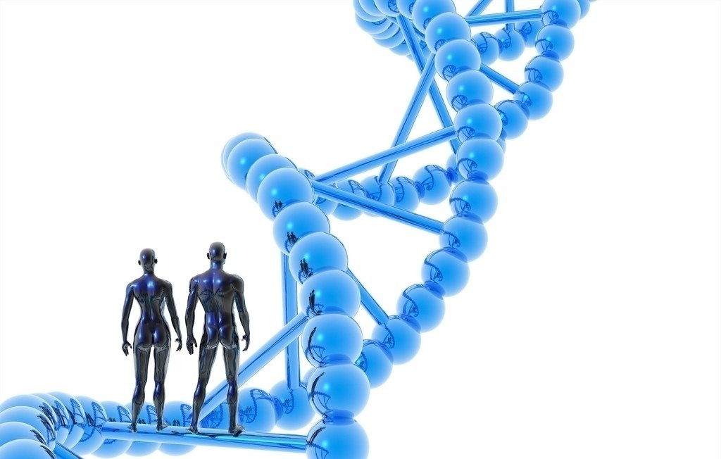
Questions？
शुक्रिया
谢谢观赏
Thank You
Notes:
http://www.nipic.com/show/2/73/5569547ka41c53f6.html

